Slide 1
Machine Learning in Business, 3rd Edition
Chapter 2: Unsupervised Learning

Slide 2
Unsupervised Learning
In unsupervised learning we are not trying to predict anything
The objective is to cluster data to increase our understanding of the environment

Slide 3
Clustering Customers
Suppose you are a bank and have hundreds of thousands of customers and 100 features describing each one
Unsupervised learning algorithms can be used to divide your customers into clusters so that you can anticipate their needs and communicate with them more effectively

Slide 4
Feature Scaling (page 24-25)
Before using many ML algorithms (including those for unsupervised learning), it is important to scale feature values so that they are comparable.
Z-score scaling involves calculating the mean and SD from the values of each feature from the training set. Scaled feature values for all data sets are then created by subtracting the mean and dividing by the SD. The scaled feature values have a mean of zero and SD of one.
Min-max scaling involves calculating the maximum and minimum value of each feature from the training set. Scaled feature values for all data sets are then created by subtracting the minimum and dividing by the difference between the maximum and minimum. The scaled feature values lie between zero and one.

Slide 5

Feature Scaling Summary
Z-score scaling: $Value→\frac{Value−Mean}{SD}$
Min-Max scaling: $Value→\frac{Value−Minimum}{Maximum−Minimum}$

Slide 6
A Distance Measure
For clustering we need a distance measure
The simplest distance measure is the Euclidean distance measure. Distance =

Slide 7
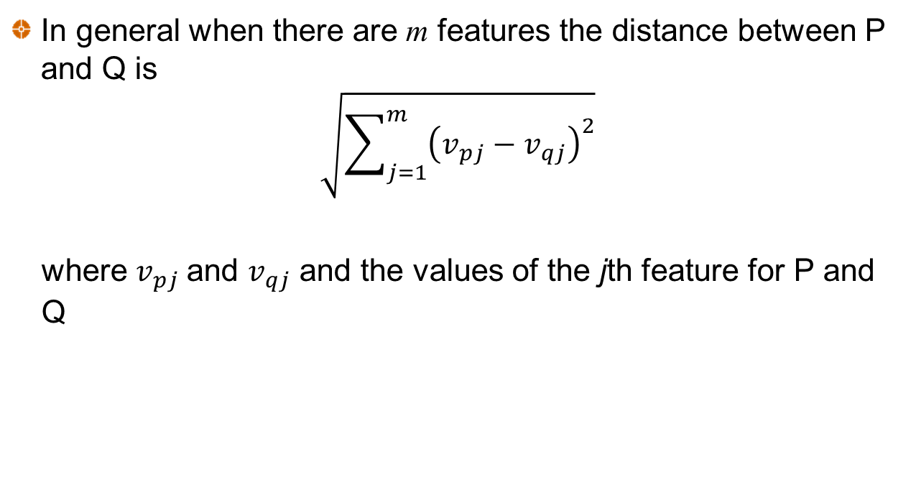
Distance Measure continued
In general when there are m features the distance between P and Q is
$$\sqrt{\sum_{j=1}^{m}{{\left(v_{pj}−v_{qj}\right)}^{2}}}$$
where $v_{pj}$and $v_{qj}$ and the values of the jth feature for P and Q

Slide 8
Cluster Centers (Table 2.1)
The center of a cluster (sometimes called the centroid) is determined by averaging the values of each feature for all points in the cluster. Example:
Observ. | Feature 1 | Feature 2 | Feature 3 | Feature 4 | Distance to center
1 | 1.00 | 1.00 | 0.40 | 0.25 | 0.145
2 | 0.80 | 1.20 | 0.25 | 0.40 | 0.258
3 | 0.82 | 1.05 | 0.35 | 0.50 | 0.206
4 | 1.10 | 0.80 | 0.21 | 0.23 | 0.303
5 | 0.85 | 0.90 | 0.37 | 0.27 | 0.137
Center | 0.914 | 0.990 | 0.316 | 0.330

Slide 9
k-means algorithm to find k clusters (Figure 2.2)
Choose k random points as cluster centers
Assign each observation to nearest cluster center
Calculate new cluster centers
End
Have cluster centers changed?
No
Yes

Slide 10
A Simple Example
Notes:
Simple example to illustrate how the algorithm works

Slide 11
Example Continued

Slide 12
Example continued

Slide 13
Example continued

Slide 14
Example continued

Slide 15
Example continued

Slide 16
Inertia
For any given k the objective is to minimize inertia, which is defined as the within cluster sum of squares:
where d_{i} is the distance of observation i from its cluster center
In practice we use the k-means algorithm with several different starting points and choose the result that has the smallest inertia

Slide 17
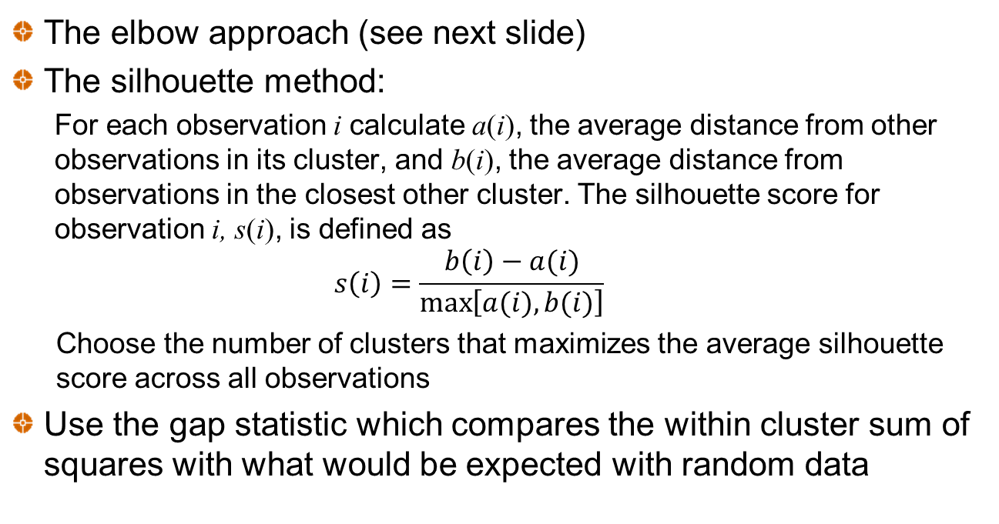
Choosing k
The elbow approach (see next slide)
The silhouette method:
  For each observation i calculate a(i), the average distance from other observations in its cluster, and b(i), the average distance from observations in the closest other cluster. The silhouette score for observation i, s(i), is defined as
  $$s\left(i\right)=\frac{b\left(i\right)−a(i)}{\max\left[a(i),b(i)\right]}$$
  Choose the number of clusters that maximizes the average silhouette score across all observations
Use the gap statistic which compares the within cluster sum of squares with what would be expected with random data

Slide 18
The elbow method (In this example k=4 is suggested)

Slide 19
The Curse of Dimensionality (page 33)
The Euclidean distance measure increases as the number of features increase.
This is referred to as the curse of dimensionality
Consider two observations that have values for feature j equal to x_{j} and y_{j}. An alternative distance measure that always lies between 0 and 2 is

Slide 20
Country Risk Case
Objective is to cluster countries according to their riskiness for foreign investment using 2019 data
Measures of Country Risk
GDP real growth rate (IMF)
Corruption index (Transparency international)
Peace index (Institute for Economics and Peace)
Legal Risk Index (Property Rights Association)
Collected data on 121 countries. Used Z-score scaling.

Slide 21
Part of Original Data (Table 2.2)
Country | Corruption Index | Peace Index | Legal Risk Index | Real GDP growth rate (% per yr)
Albania | 35 | 1.821 | 4.546 | 2.983
Algeria | 35 | 2.219 | 4.435 | 2.553
Argentina | 45 | 1.989 | 5.087 | −3.061
Armenia | 42 | 2.294 | 4.812 | 6.000
Australia | 77 | 1.419 | 8.363 | 1.713
Austria | 77 | 1.291 | 8.089 | 1.605

Slide 22
Data after Z-score Scaling
Country | Corruption Index | Peace Index | Legal Risk Index | Real GDP growth rate (% per yr)
Albania | −0.633 | −0.390 | −0.878 | 0.127
Algeria | −0.633 | 0.472 | −0.959 | −0.041
Argentina | −0.099 | −0.026 | −0.484 | −2.231
Armenia | −0.259 | 0.635 | −0.685 | 1.304
Australia | 1.612 | −1.261 | 1.900 | −0.368
Austria | 1.612 | −1.539 | 1.701 | −0.411

Slide 23
Scaled corruption and legal risk were highly correlated
Therefore analysis based on
GDP growth rate
Peace index
Legal risk index

Slide 24
How the total within-cluster sum of squares declines as k increases when k-means algorithm is used (Figure 2.6)

Slide 25
Silhouette scores (suggest k=3)
Number of clusters | Average silhouette score
2 | 0.351
3 | 0.360
4 | 0.340
5 | 0.344
6 | 0.348
7 | 0.355
8 | 0.355
9 | 0.332

Slide 26
Cluster centers (scaled values) Table 2.5
Note that high values for the peace index are bad whereas high values for the legal risk index are good
 | Peace index | Legal index | GDP
High risk | 1.35 | −0.83 | −1.11
Moderate risk | 0.22 | −0.55 | 0.60
Low risk | −0.85 | 1.02 | −0.24

Slide 27
Hierarchical Clustering (page 39-40)
Start with each observation in its own cluster
Combine the two closest clusters
Continue until all observations have been combined into a single cluster
Can be implemented in Python with AgglomerativeClustering.
Measures of closeness of clusters:
  Average Euclidean distance between points in clusters
  Maximum distance between points in clusters
  Minimum distance between points in clusters
  Increase in inertia (a version of Ward’s method)

Slide 28
Density-based clustering
Forms clusters based on the closeness of individual observations
Unlike k-means the algorithm, it is not based on cluster centers.
We might initially choose 8 observations that are close. After that we add an observation to the cluster if it is close to at least 5 other observations in the cluster, and repeat.

Slide 29
Density-based Clustering Examples

Slide 30
Distribution-based Clustering
Assumes that observations come from a mixture of distributions and uses statistical procedures to separate the distributions

Slide 31
Principal Components Analysis
This is another approach to reducing the number of variables
PCA replaces a set of n variables by n factors so that:
  Any observation on the original variables is a linear combination of the n factors
  The n factors are uncorrelated
  The quantity of a particular factor in a particular observation is the factor score
  The importance of a particular factor is measured by the standard deviation of its factor score across observations
The idea is to find a few variables that account for a high percentage of the variance in the observations

Slide 32
Example: Daily interest rate changes
Maturity | PC1 | PC2 | PC3
1yr | 0.083 | −0.242 | 0.685
2yr | 0.210 | −0.465 | 0.376
3yr | 0.286 | −0.467 | 0.006
5yr | 0.386 | −0.315 | −0.332
7yr | 0.430 | −0.099 | −0.349
10yr | 0.428 | 0.119 | −0.153
20yr | 0.426 | 0.394 | 0.172
30yr | 0.411 | 0.478 | 0.323

Slide 33

Interest rate changes continued
SD of factor scores
The fraction of the variance accounted for by first factor is
or about 87.3%.
The first two factors account for about 95.6% of the variance
PC1 | PC2 | PC3
11.54 | 3.55 | 1.78
$$=\frac{{11.54}^{2}}{{11.54}^{2}+{3.55}^{2}+1.78^{2}+⋯}$$

Slide 34
Application to Country Risk case when all 4 features are used (Tables 2.11 and 2.12)
 | PC1 | PC2 | PC3 | PC4
Corruption index | 0.602 | −0.015 | 0.328 | 0.728
Peace index | −0.524 | 0.201 | 0.825 | 0.065
Legal risk index | 0.594 | 0.022 | 0.425 | −0.683
GDP Growth rate | 0.103 | −0.979 | 0.174 | −0.013
 | PC1 | PC2 | PC3 | PC4
SD of factor scores | 1.600 | 1.001 | 0.614 | 0.243
% of variance | 64% | 25% | 9% | 2%

